Slide 1
Install Nagios Tool from Docker Hub
Open Docker Desktop
Open PowerShell as administrator and type the following command
docker pull jasonrivers/nagios:latest
3. This command will pull the Nagios image from the Docker Hub

Slide 2
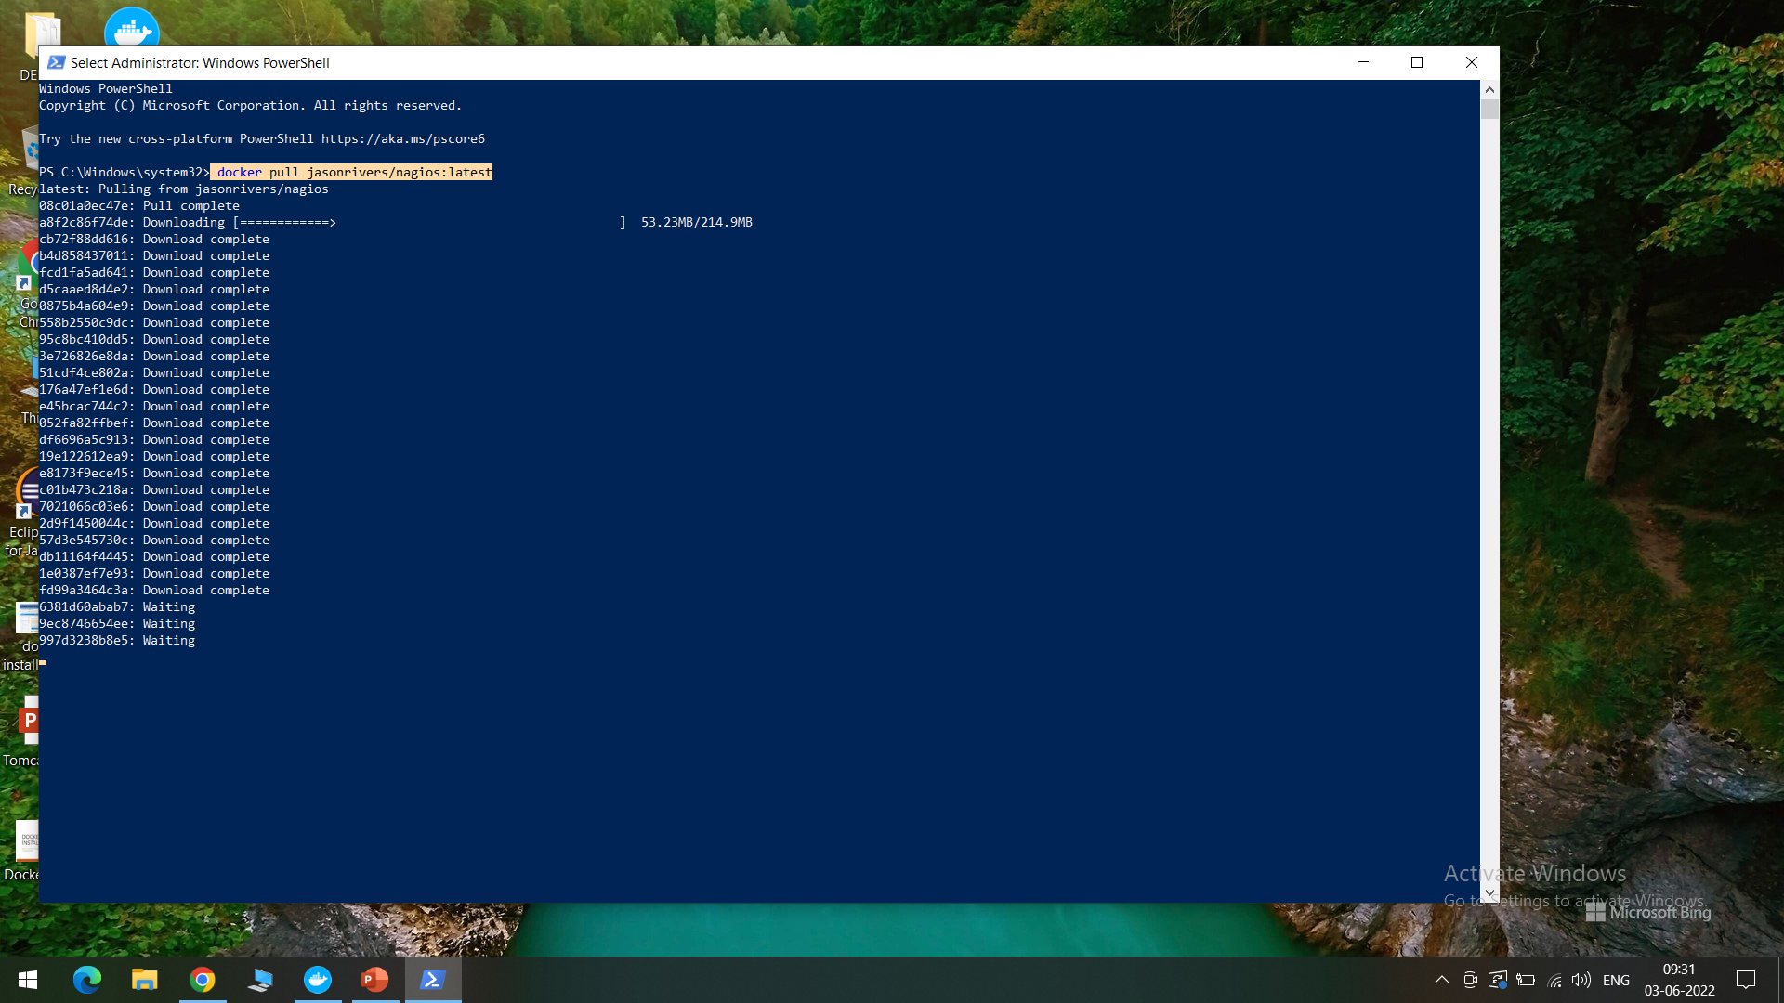
The command will pull and download necessary images

Slide 3
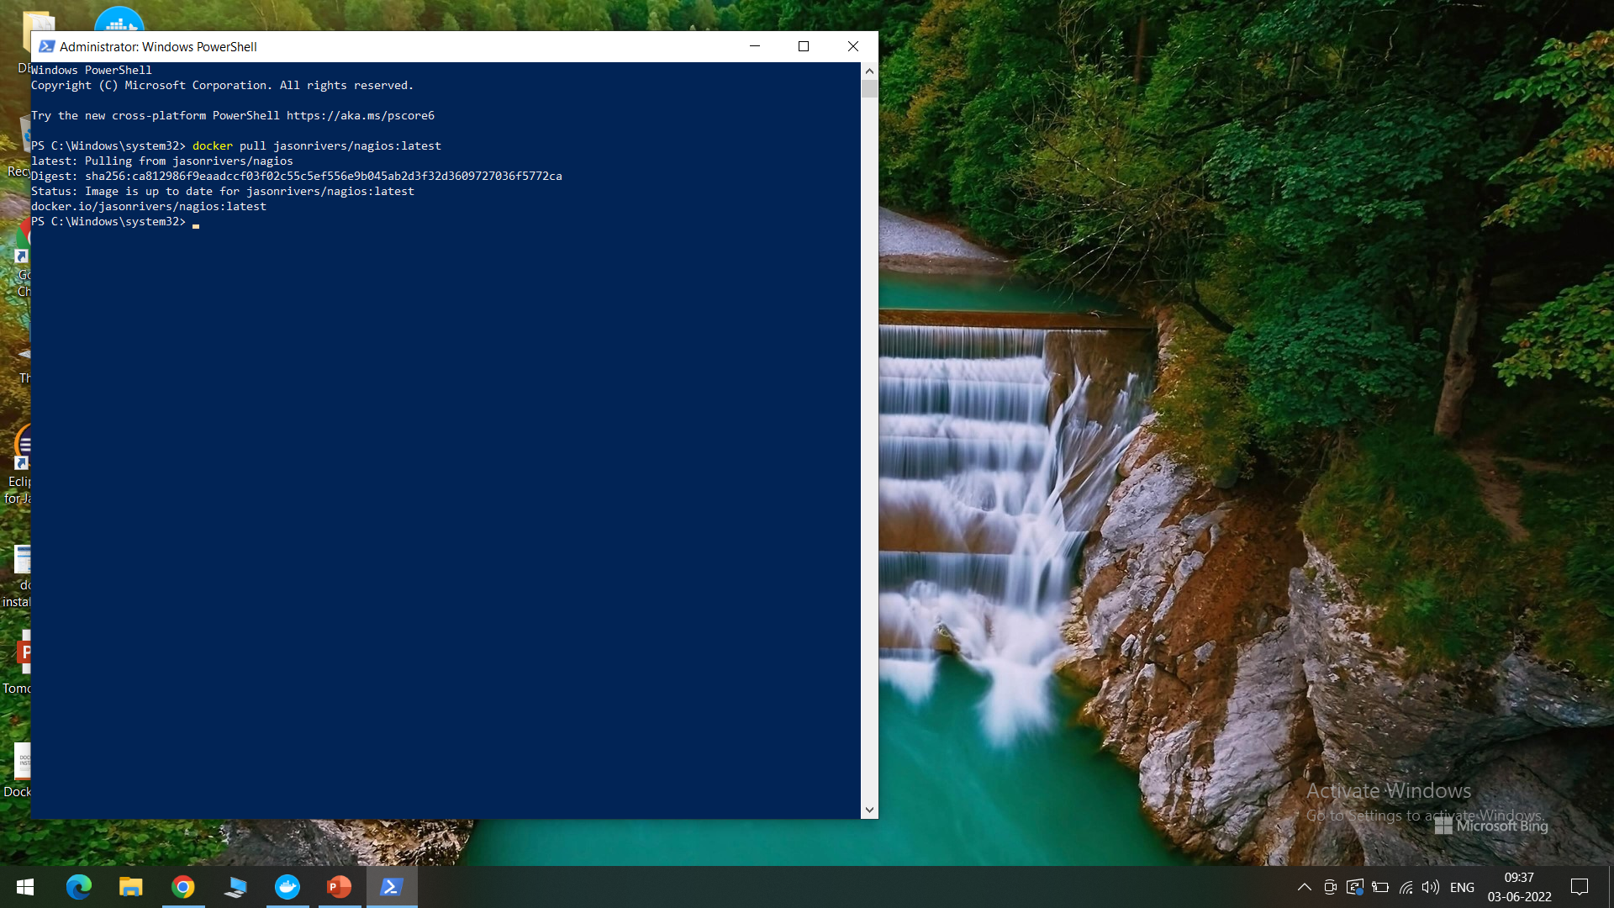
Nagios is successfully pulled

Slide 4
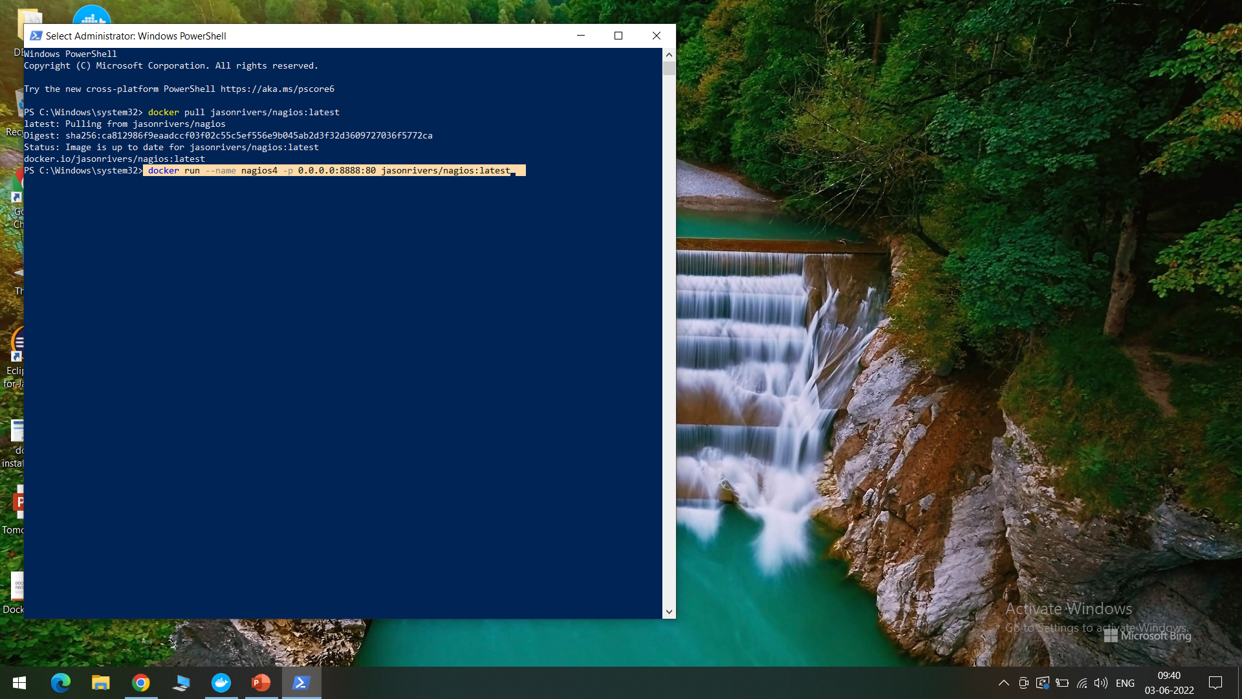
Run NAGIOS
The following highlighted command is used to run Nagios

Slide 5
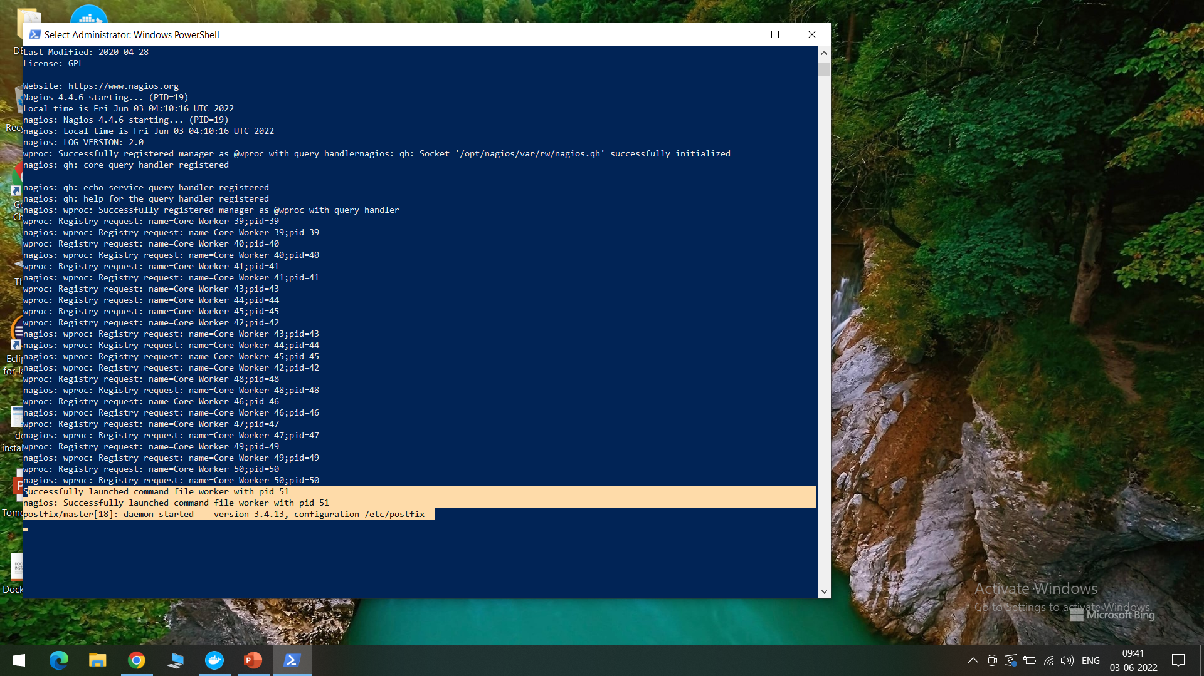
We can observe the successfully launched message as shown

Slide 6
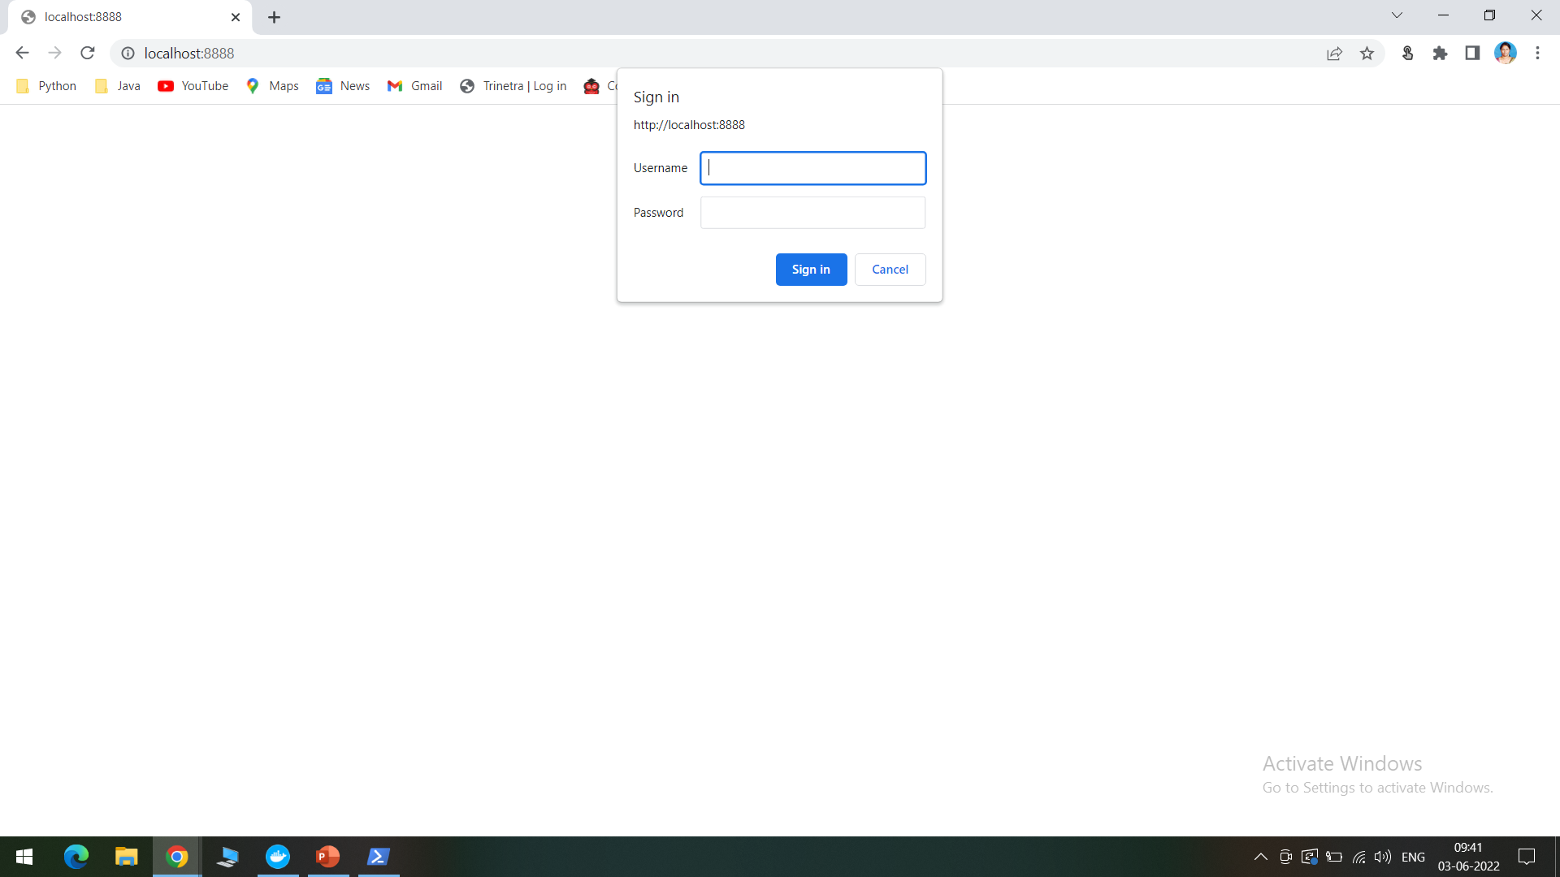
NAGIOS WebGUI
We can access Nagios by opening the browser and typing localhost:8888, as shown

Slide 7
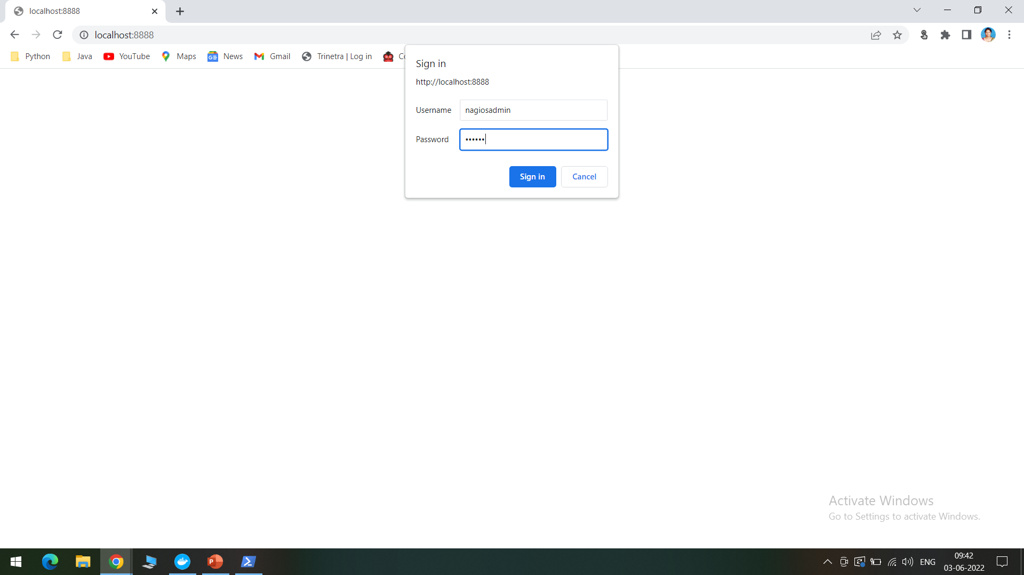
Provide the following details:
Username : nagiosadmin
Password: nagios

Slide 8
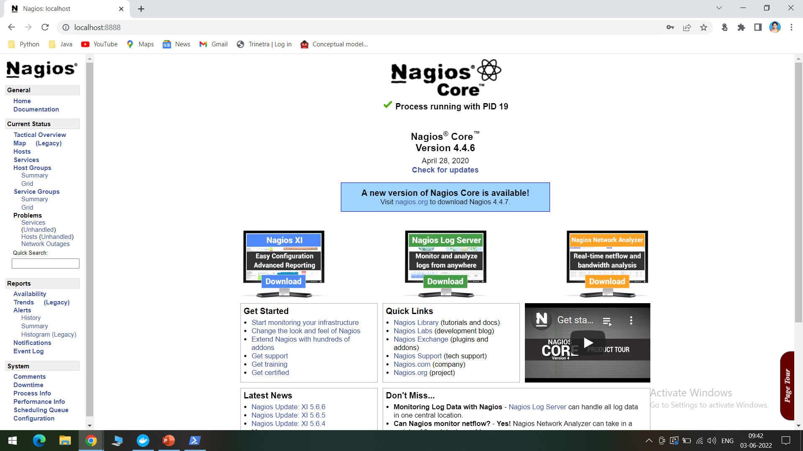
Nagios Dashboard
The Nagios dashboard will be opened, we can now monitor the services

